Slide 1
Pattern Extraction
Stauffer Guy-Raphaël and Chevalley Gibran

Slide 2


Previous work

Slide 3
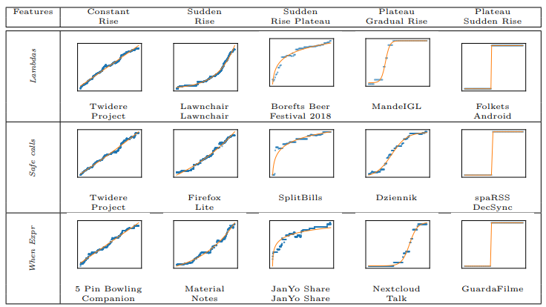
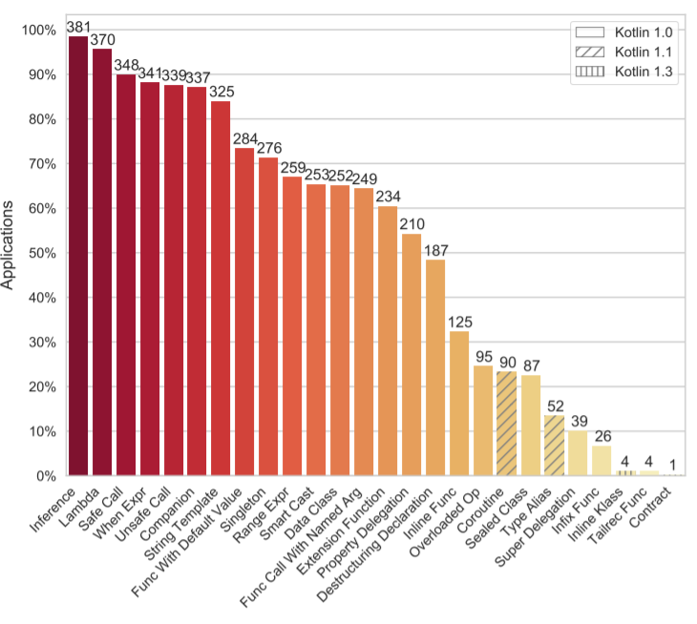
Previous work

Slide 4




Project scope
+
1
Downloads Github projects
Extracts patterns
Ouputs statistics
Statistics analysis

Slide 5
Conception

Slide 6


Conception: Github

Slide 7

Conception: Github
git clone https://github.com/Alamofire/Alamofire
find . -type f -name "*.swift"
GET https://api.github.com/search/repositories
?q=language:Swift&sort=stars&order=desc
git log --name-only --follow -- Main.swift
git checkout 0453335d…cc9155ef Main.swift
copy Main.swift to ../files/Alamofire/Alamofire/0000_Main.swift/04533…/

Slide 8
Conception: Github
apple/
swift/
0000_Main.swift/
3ac8b92fb595d54b365dee885885e3d7a22c7649/
Main.swift
0453335d5e47781fdd788299920dd380cc9155ef/
Main.swift
…
0001_Requires.swift/
...
Alamofire/
Alamofire/
0000_ContentView.swift/
603defe1fe8ba465da412767fc45e68edac9bc0a/
ContentView.swift
…
0001_DispatchQueue+Alamofire.swift/
…
…

Slide 9



Conception: Github
1
?
Filters out single swift file projects
Renamed files in commit history
Checkout forced push commits

Slide 10
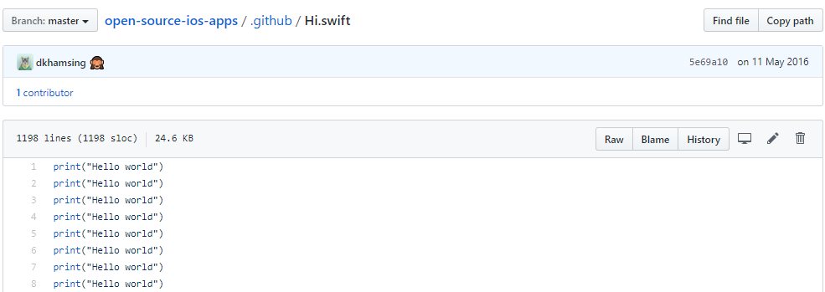
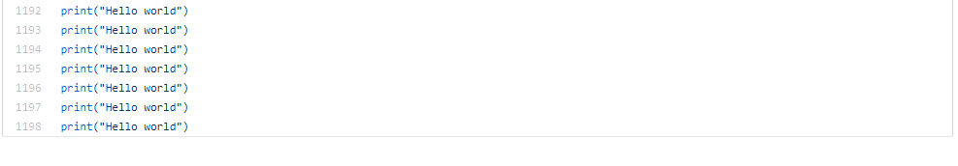
…

Slide 11
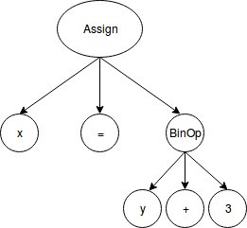
Conception: Pattern counting
AST

Slide 12
Conception: Pattern counting
https://github.com/yanagiba/swift-ast
func visit(_ stmt: ClosureExpression) throws -> Bool {
count += 1
return true
}

Slide 13

Conception: Pattern counting
Commits
+
1
+
1
…
+
1
+
1
…
+
1
+
1
…
…

Slide 14
Utilisation

Slide 15
Repository choices
150
Swift
Descending order of stars
27
123
Filtered out
Projects left

Slide 16
Extracted patterns
Protocol declaration
Class declaration
Struct declaration
Retroactive modeling
Protocol extension
Protocol with associated datatype
Bounded polymorphism
Optional chaining
Optionals
Inline functions
Closure
Infered types
Variable declaration
Constant declaration

Slide 17
Results

Slide 18
Results

Slide 19
Results

Slide 20
Results

Slide 21
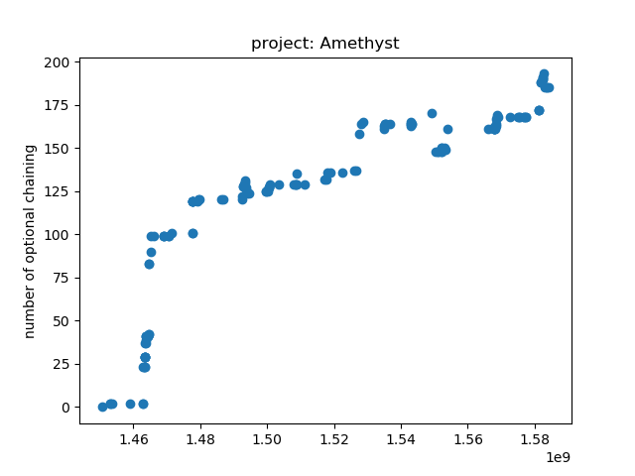
Evolution of specific feature in project

Slide 22
Original project
Mateus, Bruno Góis, et Matias Martinez. « On the Adoption, Usage and Evolution of Kotlin Features on Android Development ». ArXiv:1907.09003 [Cs], 20 janvier 2020. http://arxiv.org/abs/1907.09003.

